Slide 1
Dev -> QA -> Production using PowerShell & Visual Studio Team Services
Thom Schumacher
24 October 2016

Slide 2



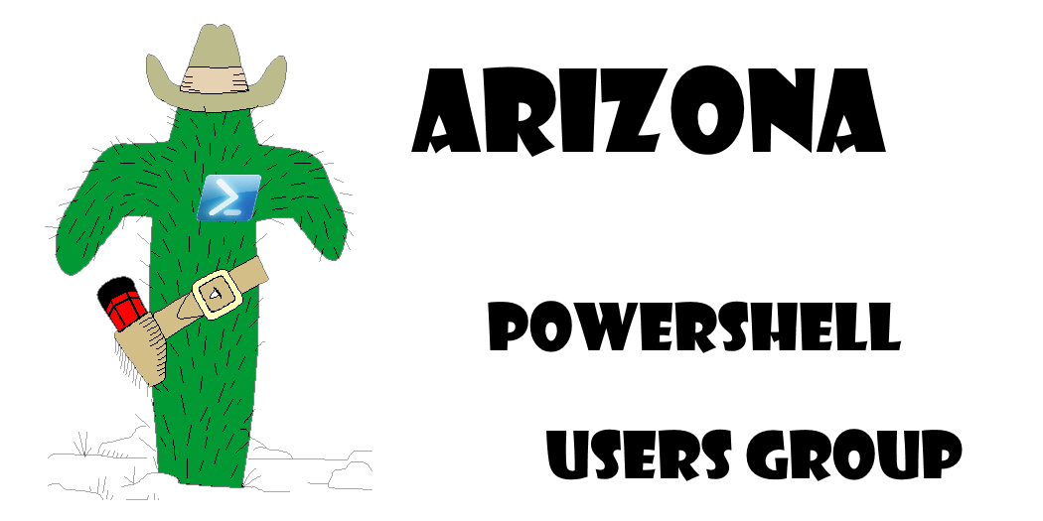

About The Presenter – Thom Schumacher
Founded the users group in Austin Texas
Leader of the Users group in Phoenix
Led / Organized the PowerShell Saturday in Phoenix
Twitter @driberif
Blog / WebSite https://powershellposse.com
Image Credit: xkcd.com

Slide 3
Script for building site
Build and add functions to the script as needed
I’ll show you how I use TFS and PowerShell as a tool to get Developers code to Dev, QA and Production systems in a timely fashion.

Slide 4
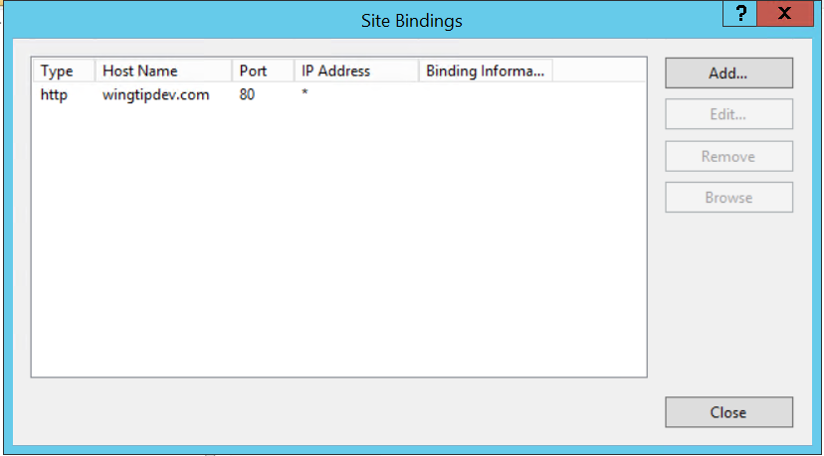
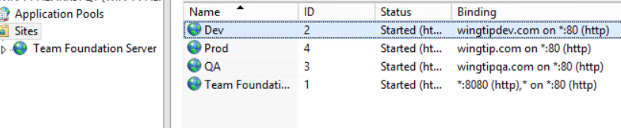
Scripts for building an IIS website
Creates Site
Sets Bindings
Iis-lib.psm1

Slide 5
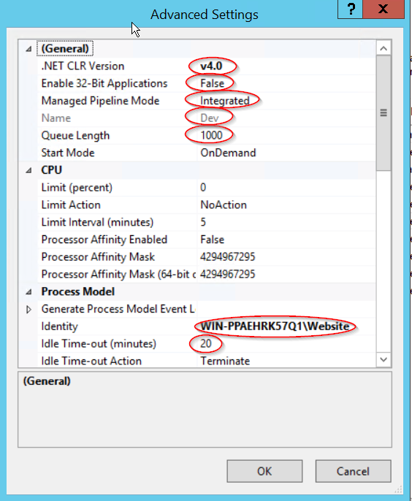
Scripts for building an IIS application pool
Identity
Dot net version
Name
Queue length
Idle timeout
Iis-lib.psm1

Slide 6
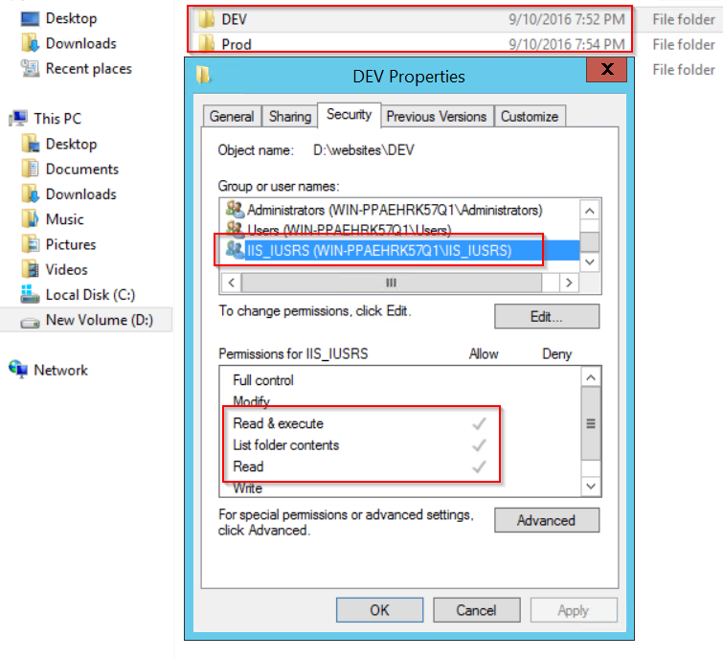
Scripts that add directory and set permissions

Slide 7
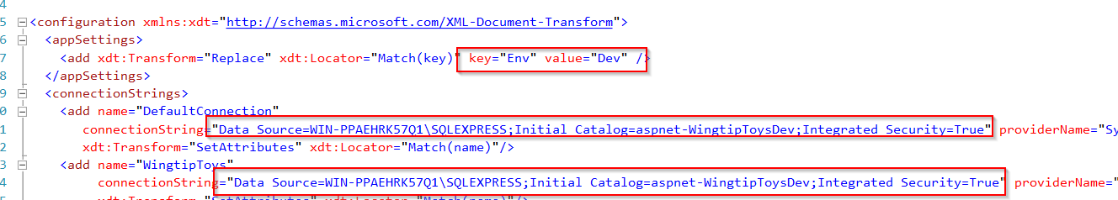
Transforming config files
Script that reads web.<env>.config and transforms the config during deployment

Slide 8
Putting it all together
Use the code shown above to allow for creation of many different environments.
Dev, QA, Prod
Using the same process for each environment.
Also allows for pushing changes iterative changes.
To support this activity Maintenance scripts are needed:
Start / Stop site/pool – IISactions.ps1
Check to ensure Site is alive and has been transformed. (configtransform.ps1)
Install new code / push new code. (tfs)
Build site if necessary (setupwingtip.ps1)
Full demo on Github: (https://github.com/crshnbrn66/Demo)

Slide 10
Questions?

